Slide 1
Encanto- which times tables do you know? https://www.youtube.com/watch?v=9nX8YlhDDcc

Slide 2
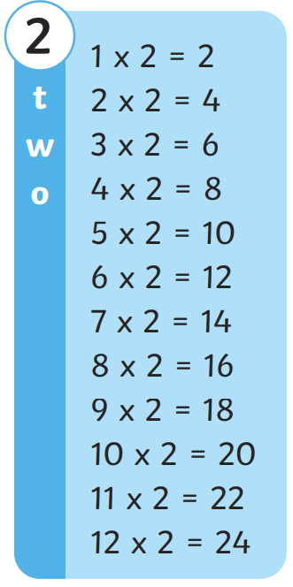
Key skills: 2 times table
Encanto- which times tables do you know?
https://www.youtube.com/watch?v=9nX8YlhDDcc
Time to reflect
Can I spot any patterns to help me remember the times table?
Time to reflect
What can I do to help me if I get stuck?
https://www.youtube.com/watch?v=GDosXgAnq80

Slide 3
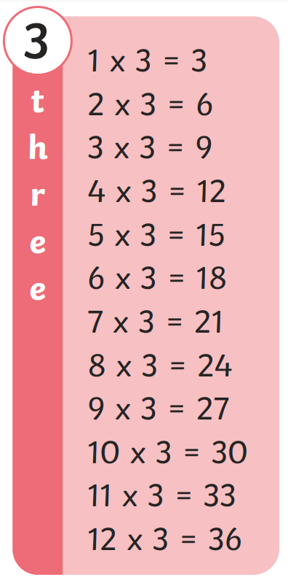
Key skills: 3 times table
Encanto- which times tables do you know?
https://www.youtube.com/watch?v=9nX8YlhDDcc
Time to reflect
Can I spot any patterns to help me remember the times table?
Time to reflect
What can I do to help me if I get stuck?
https://www.youtube.com/watch?v=JG8hRwH3JJM
https://www.youtube.com/watch?v=r7eGyNUwP6o

Slide 4
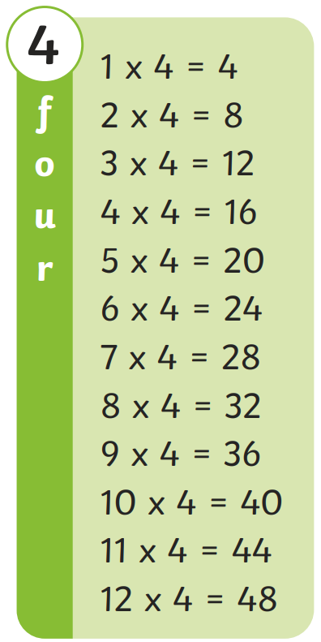
Key skills: 4 times table
Encanto- which times tables do you know?
https://www.youtube.com/watch?v=9nX8YlhDDcc
Time to reflect
Can I spot any patterns to help me remember the times table?
Time to reflect
What can I do to help me if I get stuck?
4 Times Table Song (As It Was by Harry Styles) (youtube.com)

Slide 5
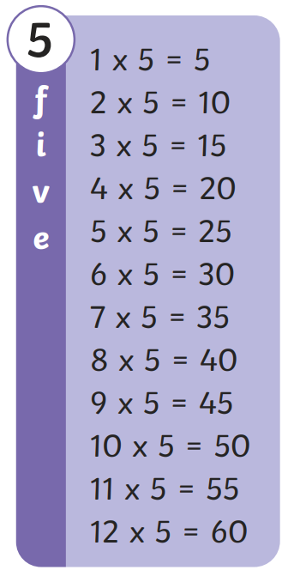
Key skills: 5 times table
Encanto- which times tables do you know?
https://www.youtube.com/watch?v=9nX8YlhDDcc
Time to reflect
Can I spot any patterns to help me remember the times table?
Time to reflect
What can I do to help me if I get stuck?
https://www.youtube.com/watch?v=6lti2YOzplw

Slide 6
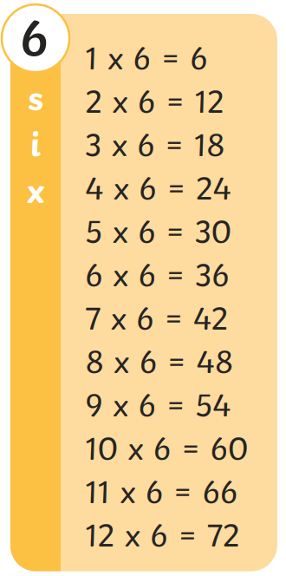
Key skills: 6 times table
Encanto- which times tables do you know?
https://www.youtube.com/watch?v=9nX8YlhDDcc
Time to reflect
Can I spot any patterns to help me remember the times table?
Time to reflect
What can I do to help me if I get stuck?
https://www.youtube.com/watch?v=jb2_akO5mdA
https://www.youtube.com/watch?v=e7rYbk9PNuM

Slide 7
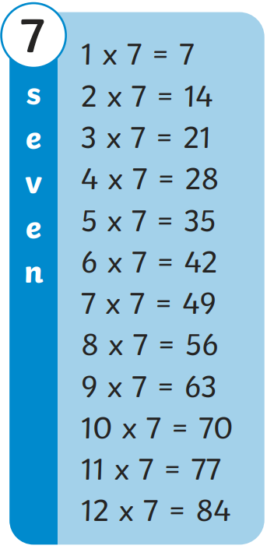
Key skills: 7 times table
Encanto- which times tables do you know?
https://www.youtube.com/watch?v=9nX8YlhDDcc
Time to reflect
Can I spot any patterns to help me remember the times table?
Time to reflect
What can I do to help me if I get stuck?
https://www.youtube.com/watch?v=eIH0LZWt_zw

Slide 8
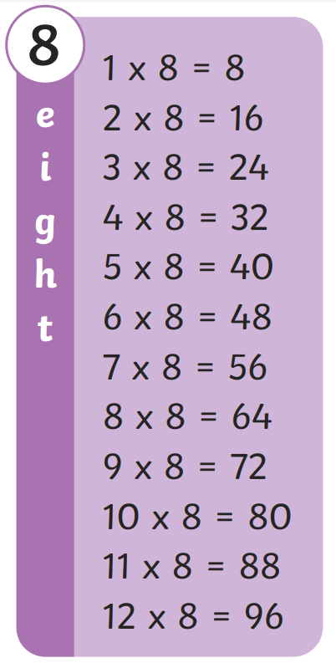
Key skills: 8 times table
Encanto- which times tables do you know?
https://www.youtube.com/watch?v=9nX8YlhDDcc
Time to reflect
Can I spot any patterns to help me remember the times table?
Time to reflect
What can I do to help me if I get stuck?
8 times table song (Sunflower by Post Malone) (youtube.com)
https://www.youtube.com/watch?v=GQ5CGguPlqY

Slide 9
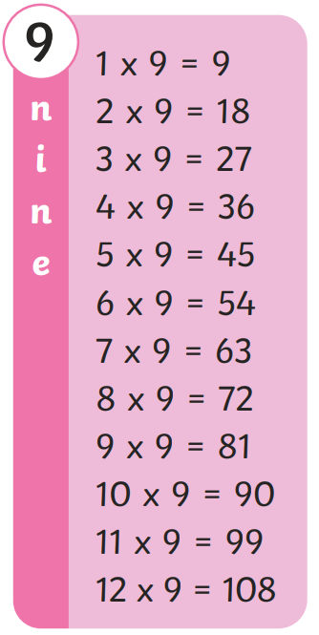
Key skills: 9 times table
Encanto- which times tables do you know?
https://www.youtube.com/watch?v=9nX8YlhDDcc
Time to reflect
Can I spot any patterns to help me remember the times table?
Time to reflect
What can I do to help me if I get stuck?
https://www.youtube.com/watch?v=tpCSKln_Gzc

Slide 10
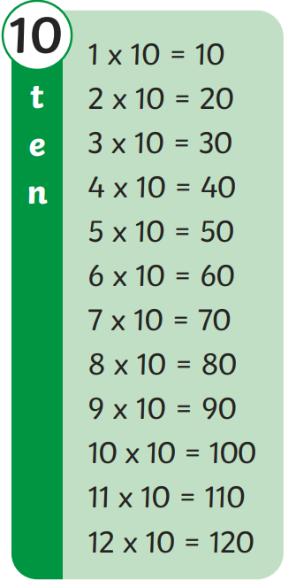
Key skills: 10 times table
Encanto- which times tables do you know?
https://www.youtube.com/watch?v=9nX8YlhDDcc
Time to reflect
Can I spot any patterns to help me remember the times table?
Time to reflect
What can I do to help me if I get stuck?
https://www.youtube.com/watch?v=Zs1uqnpnltI

Slide 11
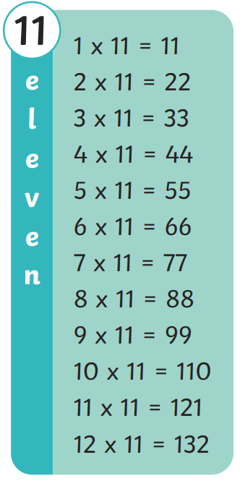
Key skills: 11 times table
Encanto- which times tables do you know?
https://www.youtube.com/watch?v=9nX8YlhDDcc
Time to reflect
Can I spot any patterns to help me remember the times table?
Time to reflect
What can I do to help me if I get stuck?
https://www.youtube.com/watch?v=vbINMtUOA78&t=7s

Slide 12
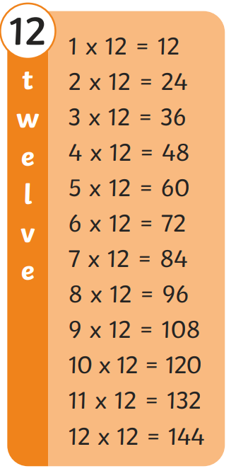
Key skills: 12 times table
Encanto- which times tables do you know?
https://www.youtube.com/watch?v=9nX8YlhDDcc
Time to reflect
Can I spot any patterns to help me remember the times table?
Time to reflect
What can I do to help me if I get stuck?
https://www.youtube.com/watch?v=yknU_qWLvLM

